Slide 1
Fraud Detection
Report : Models with both features dropped after FE & EDA

Slide 2
Features & their correlation
‘Fraud_label’ is our target feature for the dataset, and the two features mentioned here are the most correlated features to the target feature.
In this version of the report, I dropped both the features after doing the FE & EDA.
After, that I used the different Machine Learning models as well as Deep Learning model ANN.
For tree-based models, I didn’t apply any scaling method.
For Distance based models, I used the Min Max scaler.
Fraud_Label 1.000000
Failed_Transaction_Count_7d 0.509871
Risk_Score 0.385810

Slide 3
Distance Based Algorithms
Logistic Regression
SVC
KNN
accuracy_score : 0.67584
Confusion matrix :
[[8448 0]
[4052 0]]
precision recall f1-score support
0 0.68 1.00 0.81 8448
1 0.00 0.00 0.00 4052
accuracy 0.68 12500
macro avg 0.34 0.50 0.40 12500
weighted avg 0.46 0.68 0.55 12500
accuracy_score : 0.67584
Confusion matrix :
[[8448 0]
[4052 0]]
precision recall f1-score support
0 0.68 1.00 0.81 8448
1 0.00 0.00 0.00 4052
accuracy 0.68 12500
macro avg 0.34 0.50 0.40 12500
weighted avg 0.46 0.68 0.55 12500
accuracy_score : 0.61416
Confusion matrix :
[[6875 1573]
[3250 802]]
precision recall f1-score support
0 0.68 0.81 0.74 8448
1 0.34 0.20 0.25 4052
accuracy 0.61 12500
macro avg 0.51 0.51 0.49 12500
weighted avg 0.57 0.61 0.58 12500

Slide 4
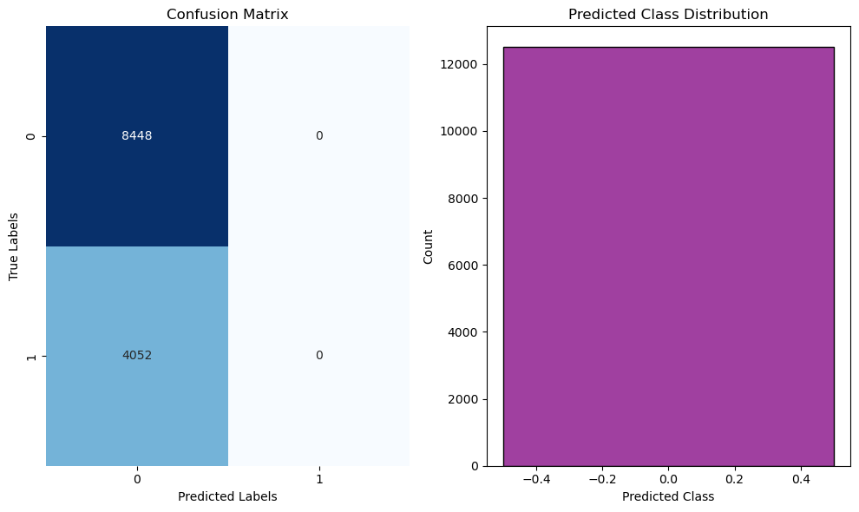
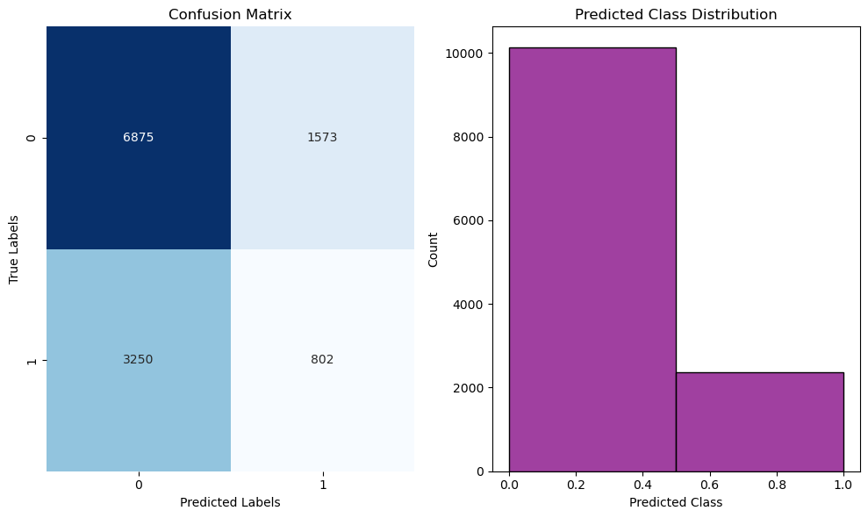
Graphs
Logistic Regression
SVC
KNN

Slide 5
Probability based Algorithm(NB)
accuracy_score : 0.67584
Confusion matrix :
[[8448 0]
[4052 0]]
precision recall f1-score support
0 0.68 1.00 0.81 8448
1 0.00 0.00 0.00 4052
accuracy 0.68 12500
macro avg 0.34 0.50 0.40 12500
weighted avg 0.46 0.68 0.55 12500

Slide 6
Tree Based Algorithms
Decision Tree
Random Forest
Adaboost
accuracy_score : 0.55432
Confusion matrix :
[[5582 2866]
[2705 1347]]
precision recall f1-score support
0 0.67 0.66 0.67 8448
1 0.32 0.33 0.33 4052
accuracy 0.55 12500
macro avg 0.50 0.50 0.50 12500
weighted avg 0.56 0.55 0.56 12500
accuracy_score : 0.67224
Confusion matrix :
[[8386 62]
[4035 17]]
precision recall f1-score support
0 0.68 0.99 0.80 8448
1 0.22 0.00 0.01 4052
accuracy 0.67 12500
macro avg 0.45 0.50 0.41 12500
weighted avg 0.53 0.67 0.55 12500
accuracy_score : 0.6756
Confusion matrix :
[[8441 7]
[4048 4]]
precision recall f1-score support
0 0.68 1.00 0.81 8448
1 0.36 0.00 0.00 4052
accuracy 0.68 12500
macro avg 0.52 0.50 0.40 12500
weighted avg 0.57 0.68 0.55 12500

Slide 7
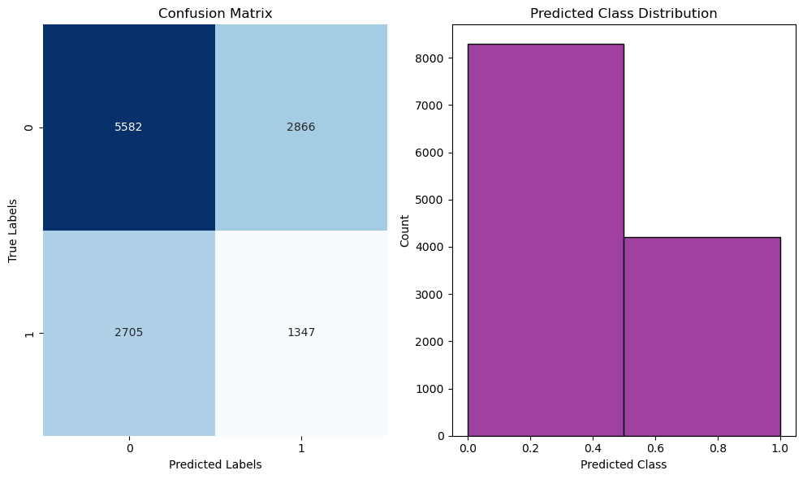
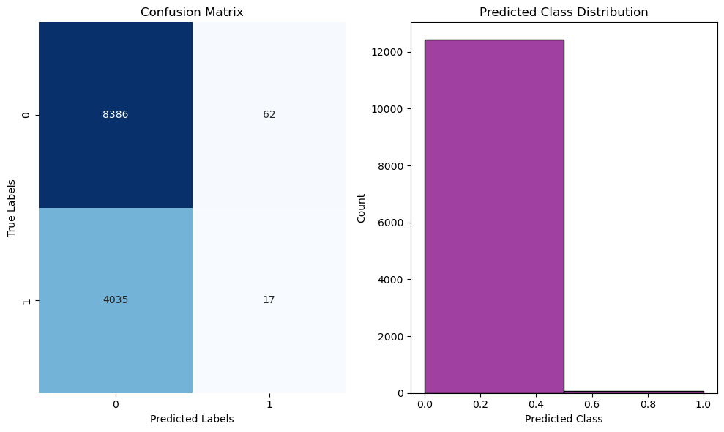

Graphs
Decision Tree
Random Forest
Adaboost

Slide 8

Gradient boost (Tree based)
accuracy_score : 0.67488
Confusion matrix :
[[8433 15]
[4049 3]]
precision recall f1-score support
0 0.68 1.00 0.81 8448
1 0.17 0.00 0.00 4052
accuracy 0.67 12500
macro avg 0.42 0.50 0.40 12500
weighted avg 0.51 0.67 0.55 12500

Slide 9
ANN(Deep learning model)
accuracy_score : 0.3316
Confusion matrix :
[[ 149 8299]
[ 56 3996]]
precision recall f1-score support
0 0.73 0.02 0.03 8448
1 0.33 0.99 0.49 4052
accuracy 0.33 12500
macro avg 0.53 0.50 0.26 12500
weighted avg 0.60 0.33 0.18 12500
Graph not available because of the results that we have got

